Slide 1
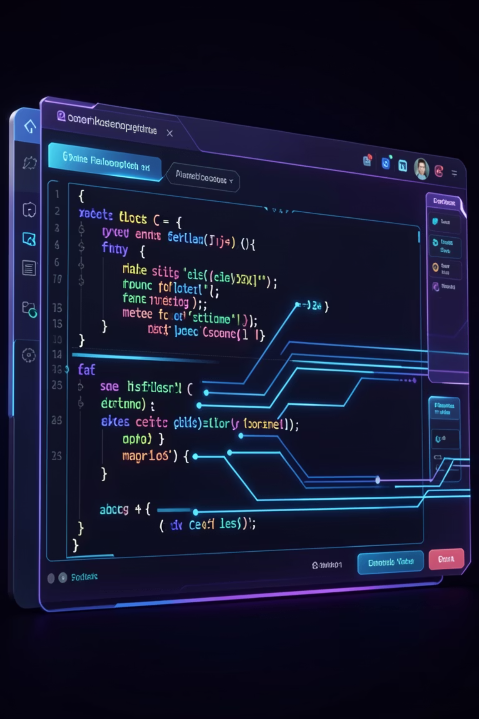
Introduction to C++ and Character Variables
Presented By:
Abdul Subhan
Muhammad Bilal
Mubeen Ali Zulfiqar
Ali Azam

Slide 2

Introduction to C++ and Character Variables
Welcome to this assignment, designed to introduce you to the powerful world of C++ programming and the fundamental concept of character variables.

Slide 3
Learning Objectives
1
2
3
C++ Fundamentals
Variables in C++
Char Variable Manipulation
Describe the core characteristics and applications of C++.
Understand the role and basic syntax of variables.
Declare, initialize, and manipulate character (char) variables.
4
5
ASCII Relationship
Escape Sequences
Explain and demonstrate char variables and their ASCII values.
Utilize escape sequences for special characters.

Slide 4

Part 1: Introduction to C++
C++ is a high-performance, general-purpose programming language created by Bjarne Stroustrup. It extends the C language, offering both low-level memory control and high-level object-oriented programming (OOP) capabilities. This versatility makes it ideal for system development, game engines, and embedded systems.

Slide 5




Key Features of C++
Object-Oriented
High Performance
Portable
Rich Library Support
Supports classes and objects, fostering code reusability and structured program design.
Provides fine-grained control over system resources and memory, leading to faster execution speeds.
C++ code can be compiled and executed across various platforms without significant modifications.
Comes equipped with a comprehensive set of built-in functions and standard library components.

Slide 7
Part 2: Variables and the char Data Type
A variable acts as a named storage location in memory, designed to hold data of a specific type. Variables enable programs to dynamically store and manipulate values during execution.
2.1 Declaring and Initializing char Variables
The char data type is specifically designed to store a single character. This character value must always be enclosed within single quotes (' ').
Basic Syntax:
char variable_name = 'value';
Examples:
char grade = 'A'; // Stores the letter A
char digit = '7'; // Stores the character '7' (not the number 7)
char symbol = '$'; // Stores the dollar sign symbol
You can also declare a variable and assign a value later:
char response;
response = 'Y';

Slide 8

2.2 The char Type and ASCII Values
In C++, a char variable doesn't directly store the character itself. Instead, it stores its corresponding integer ASCII (American Standard Code for Information Interchange) value.
The character 'A' has an ASCII value of 65.
The character 'a' has an ASCII value of 97.
The character '5' has an ASCII value of 53.
Understanding this relationship allows you to:
1. Find the ASCII value:
2. Assign a character via ASCII:
char ch = 'h';
cout << int(ch); // Outputs: 104
char ch = 104; // 104 is ASCII for 'h'
cout << ch; // Outputs: h
This explains why '5' (ASCII 53) is distinct from the integer 5 when stored in a char.

Slide 9
2.3 Escape Sequences
Certain characters, such as single quotes or newlines, cannot be directly typed into character literals. Escape sequences, which begin with a backslash (\), provide a solution for representing these special characters.
Escape Sequence
Character Represented
\'
Single quote
\"
Double quote
\\
Backslash
\n
Newline
\t
Horizontal tab
\0
Null character
Example:
cout << "He said, \"Hello!\"" << endl; // Prints: He said, "Hello!"
cout << "Line 1\nLine 2"; // Prints on two separate lines
char singleQuote = '\''; // Stores a single quote character

Slide 10
Part 3: Practical Coding Exercises
Put your knowledge into practice with these hands-on coding exercises!
01
02
Exercise 1: Basic Declaration and Output
Exercise 2: Exploring ASCII Values
Declare and initialize three char variables (initial, digit, punctuation). Print them on one line, then each on a new line.
Assign a letter to a char, print its ASCII value. Add 1 to the char, and observe the new character and its ASCII value.
03
04
Exercise 3: Working with Escape Sequences
Exercise 4: Character Input
Use cout and escape sequences to precisely print a multi-line string containing a file path, a quoted phrase, and an indented line.
Enhance Exercise 1 by taking a user-provided character input and including it in your output.

Slide 11

Hints for Success
For Exercise 3, remember to use \\\\ for a literal backslash, \" for double quotes, \n for newlines, and \t for tabs.
You can chain multiple << operators in a single cout statement to print several items.
Don't forget to include the necessary headers like <iostream> for input/output operations.
Experiment and compile your code frequently to catch errors early!

Slide 12

Resources for Research
Further your understanding with these valuable online resources:
W3Schools C++ Tutorial: Introduction & Variables
Programiz: C++ char Type
cplusplus.com Tutorial: Variables and types
These resources offer detailed explanations and additional examples to support your learning journey.

